Slide 1
Technical Project Report

Slide 2
A report is a
Reconstruction of an investigation
Reconstruct: build or form (something) again

Slide 3
The project report
The project report is the formal record of the entire process you undertook to complete your Personal Project.

Slide 4
Anatomy of a Report
Format and Components
Prefatory Parts
The Text
Chapter 1 – Introduction
Chapter 2 – Literature Review
Chapter 3 –Requirements / Analysis
Chapter 4 – Design
Chapter 5 – Implementation and test
Chapter 6 – Evaluation
Chapter 7 – Conclusion
Supplementary Parts

Slide 5
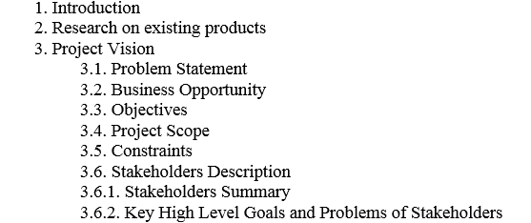
Development FYP Report Format

Slide 6
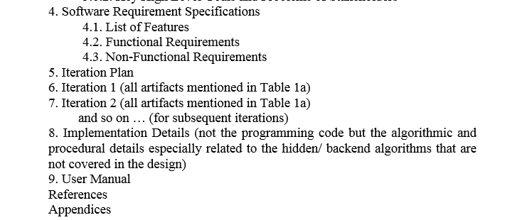
Development FYP Report Format

Slide 7
Introduction Chapter/Section
Motivation
Why the area is important
Giving background information
Reviewing previous research
Identifying a problem or a need
Establishing a specific problem or need
End with statement of the problem

Slide 8
Introduction- Format and Components
Project Vision
3.1. Problem Statement
3.2. Business Opportunity
3.3. Objectives
3.4. Project Scope
3.5. Constraints
3.6. Stakeholders Description
3.6.1. Stakeholders Summary
3.6.2. Key High Level Goals and Problems of Stakeholders

Slide 9
Example
The project designed and developed an airline reservation system which the users can use to book a flight and obtain flight details.
1. To simplify the flight reservation process for customers
2. To provide the users with a safe and secure online payment gateway
3. To allow users to obtain all flight details including departure time, delays, check in time

Slide 10
Examples of Objectives
The objectives of this Online Examination System are:
To automate the testing activity.
To centralize control of all the units that are involved in the online testing system.
To provide data security from unauthorized users.

Slide 11
Examples of Objectives
The main goal of this online pharmacy is
to assist the user in easily finding medicines that are available
To suggest alternate stores if the medicine is unavailable
To provide the admin with a mechanism to determine the validity of a prescription

Slide 12
The project developed a computerized menu system which automates the process of placing and tracking orders for any eatery or restaurant.
The objectives of the project are
1. To provide a detailed menu to the customer
2. To present reviews of different items
3. To enable the customer to place order through a mobile application
4. To inform the customer about the delays in orders or time remaining in serving of the order

Slide 13
Scope of the Project
Project scope is the part of project planning that involves determining and documenting a list of specific project goals, deliverables, tasks, costs and deadlines. The documentation of a project's scope is called a scope statement or terms of reference. It explains the boundaries of the project, establishes responsibilities for each team member and sets up procedures for how completed work will be verified and approved.

Slide 14
Scope of the Project
Project scope is description about what you would be delivering at the end to the client and are what the boundaries of your project.

Slide 15
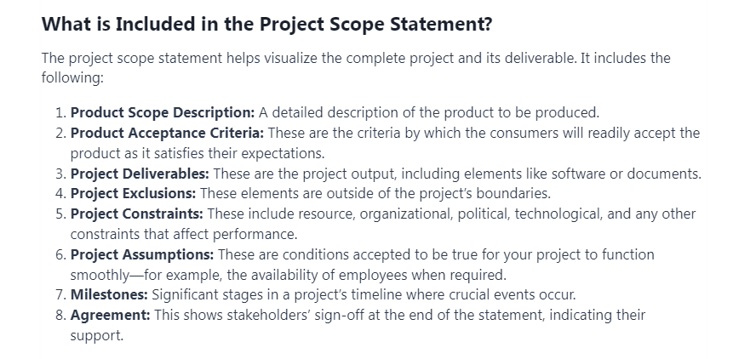

Slide 16
More on Scope
https://pmstudycircle.com/project-scope-statement/
https://www.betterup.com/blog/project-scope

Slide 17
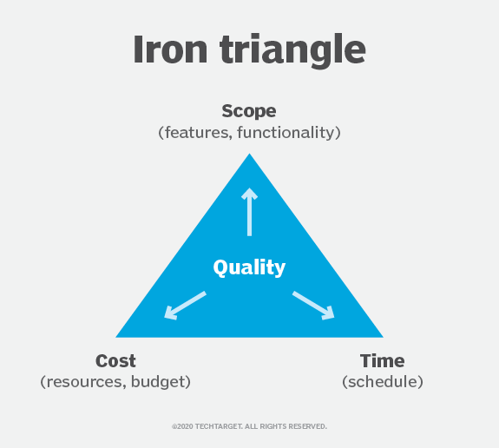
Introduction Chapter/Section
Constraints in Projects

Slide 18
Introduction Chapter/Section
A constraint in project management is any restriction that defines a project's limitations. For example, a project's scope is the limit of what the project is expected to accomplish.
The three most significant project planning and management constraints are time, cost and scope. They are sometimes known as the triple constraint or the project management triangle or the iron triangle.

Slide 19
Introduction Chapter/Section
Scope refers to the breadth and depth of features and functionalities incorporated into the software. It defines the boundaries of the project, outlining the project’s specific capabilities.
Cost represents the financial investment allocated to various aspects of software development, including initial development, necessary resources, and ongoing maintenance. Cost includes financial investments in not only the software itself but also labor, vendors, quality control, tools, etc.
Time dictates the deadlines for project delivery and establishes key milestones throughout the development process. This also includes the project’s schedule and the time at which each part of the project should be completed, including final delivery.

Slide 20
Introduction Chapter/Section
More reading on Constrainst
https://www.techtarget.com/whatis/definition/constraint-project-constraint#:~:text=A%20constraint%20in%20project%20management,are%20time%2C%20cost%20and%20scope.
https://www.apriorit.com/dev-blog/how-to-manage-constraints-in-software-development-effectively

Slide 21
Who are stakeholders?
End User and Beneficiaries
Direct User
Secondary User
Beneficiaries-Customers and Vendors

Slide 22
Who are stakeholders?
Direct users
Those who will use the software directly are usually most concerned with how it will fit into their current workflows. They want to know that it solves a significant problem or otherwise makes their job easier.
Secondary users
Direct users interact with the software itself. Secondary users rely on the products of the software. New software needs to produce results in a format that fits into secondary users’ workflows. Forgetting about this group can cause one problem while solving another, like suddenly generating reports in a format secondary users can’t integrate into their analytics.
Beneficiaries
These are all the people affected by the software’s products. The term encompasses a huge base of customers and vendors who focus more on results than process. Their input should revolve around the services or information the software will provide.

Slide 23
Literature Review Chapter
A literature review is a piece of academic writing demonstrating knowledge and understanding of the academic literature on a specific topic placed in context. A literature review also includes a critical evaluation of the material; this is why it is called a literature review rather than a literature report. It is a process of reviewing the literature, as well as a form of writing.

Slide 24
Literature Review Chapter
Introduce Research Area, technology
Define it
Discuss its significance with respect to stakeholders and business benefits
Discuss how the tech solves different problems for the stakeholders and provides different benefits

Slide 25
Literature Review Chapter
Discuss current state of the art of the technology, everything it can do, research niches, major achievements
Discuss latest research studies on the tech
Discuss the studies method wise and feature wise
Discuss limitations/weaknesses of the studies acknowledging their contribution

Slide 26
Literature Review Chapter
Now create a need for a solution
End with your research problem
Re-discuss your project objectives
Bonus: tools, languages, software packages, etc.

Slide 27
Method
Specifications-SDS
Software Design Specifications-SRS
Implementation
Tests to be Run

Slide 28
Results and Evaluation
Describe the tests you will run.
Provide reasoning behind the choice of tests
Provide a comprehensible summary of the results of all the tests conducted
Describe the extent to which you achieved your goals

Slide 29
Conclusion and Recommendations
Conclusion
Summary of all previous chapters except literature review
Appraisal of project
Critically evaluate your results
Describe strengths and weaknesses
Compare your work with others

Slide 30
Conclusion and Recommendations
Recommendations
For stakeholders, encourage them to use the proposed solution
For researchers---provide practical idea about how to extend the project
Discusses project limitations and provide ideas about improvements

